Slide 1
DL Meeting 1
Paper Survey
2020/5/18
徐靖憲
電機通訊學院英語學士班 3A

Slide 2
Our goals – publish papers
Deep learning field top conferences paper (non CV): AAAI, IJCAI, ICML, NeurIPS …..
Deep learning field top conferences paper (CV):
CVPR, ICCV, ECCV…….
Others: Sensors(MDPI)

Slide 3
Survey Paper Keyword
Time series analysis
Recurrent neural network
Human computer interaction(HCI)
Human activity recognition(HAR)
Sensor….

Slide 4
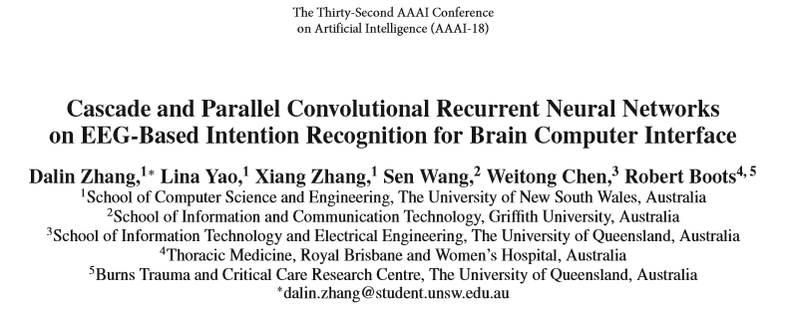

Slide 5
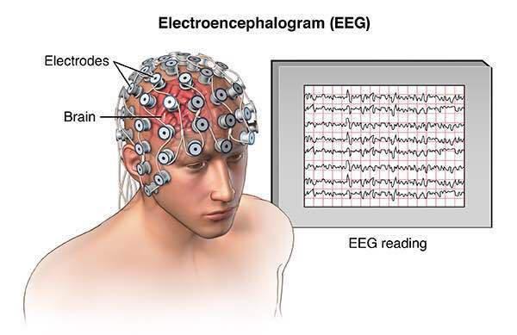
Why read this paper?
Deep learning
Based method
Extract feature/pattern
2. Analyze the behavior
Biomedical signal
Signals from our body
Many sensing point
(Time series signals)

Slide 6
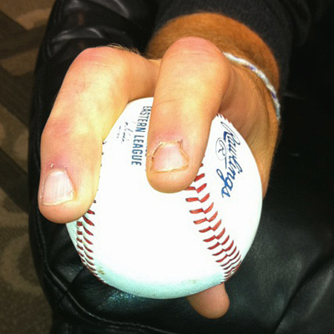
Why read this paper?
Similarity?
Baseball finger force sensing
Deep learning
Based method
Extract feature/pattern
2. Analyze the behavior
Biomedical signal acquisition
Signals from our body
Many sensing point
(Time series signals)

Slide 7
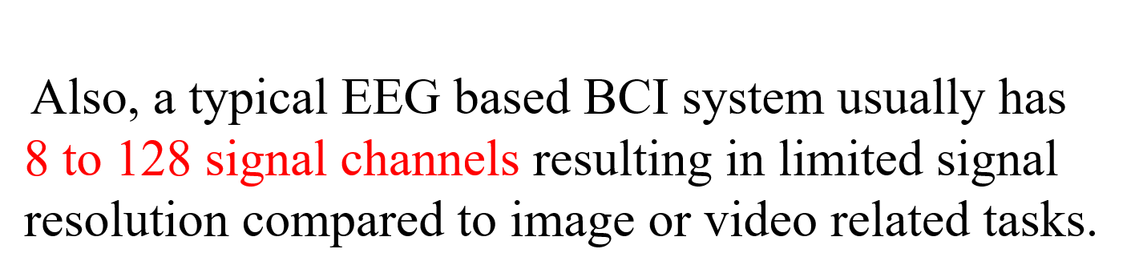
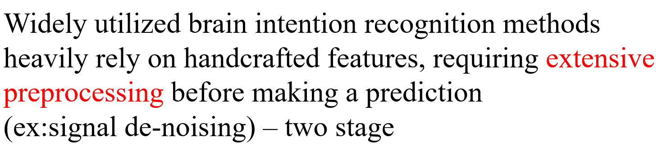
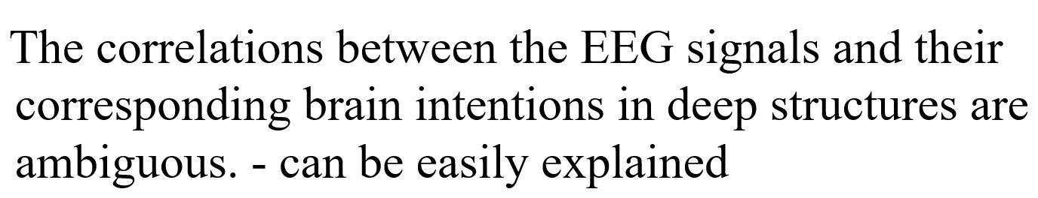
Challenges
During the recording process, physiological activities like
eye blinks, muscle activity and heart beat are all harm to
collecting high signal-noise ratio EEG signals.

Slide 8
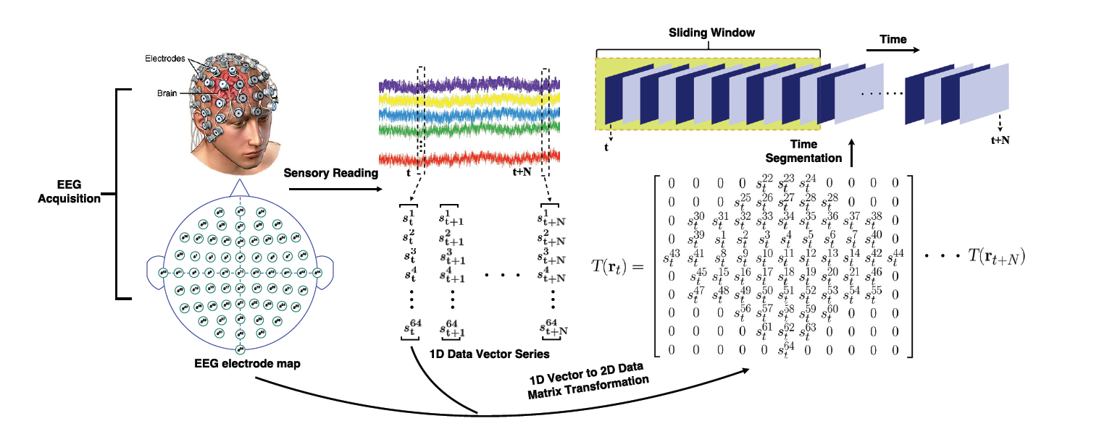
Data acquisition and preprocessing
Recorded as time series data vectors. These data vectors are then converted to 2D data
meshes according to the electrode map of the BCI headset. The converted 2D meshes are
finally segmented to clips using sliding window techniques.

Slide 9
mesh-like raw EEG signal hierarchy from
1D chain-like EEG vectors by mapping the EEG recordings
with the spatial information of EEG acquisition electrodes
to align the correlations between neighbouring EEG signals
and corresponding brain areas

Slide 10
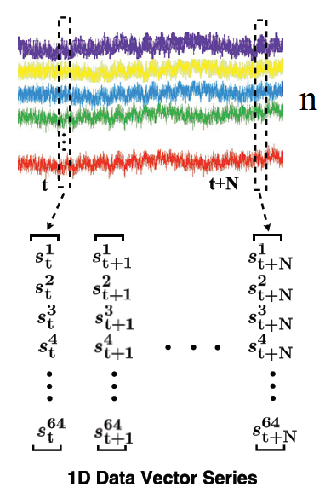
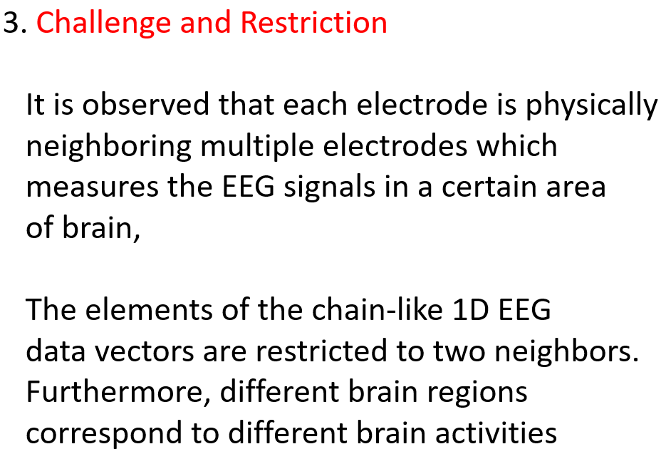
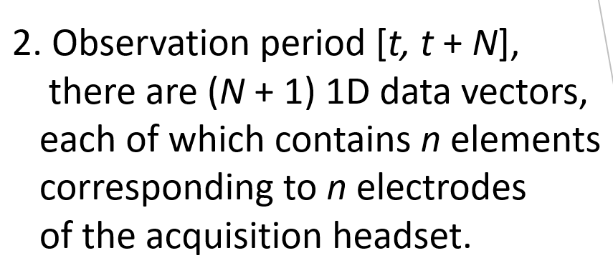


Converting 1D EEG Sequences to 2D EEG Meshes
1. Typically, the raw data from EEG
signal acquisition system at time
index t is a one-dimensional (1D)
data vector rt =
Where is the reading data of the
ith electrode channel at time

Slide 11
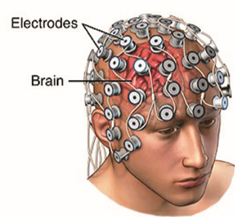

Slide 12


Similar challenge and restriction

Slide 13
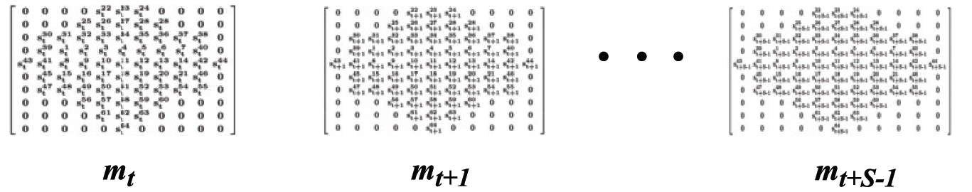
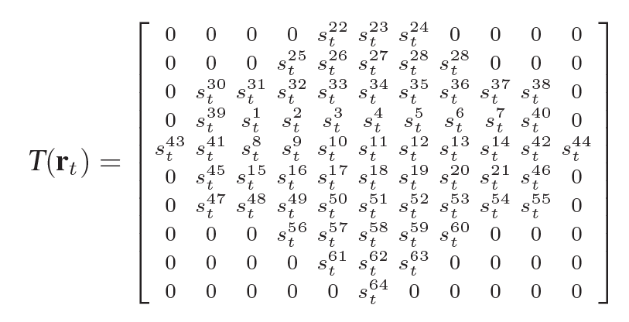
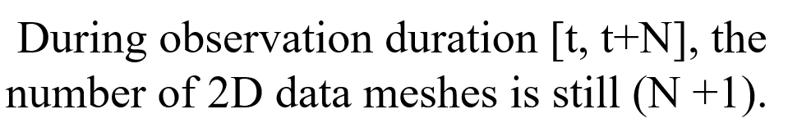
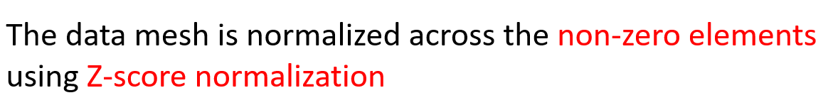
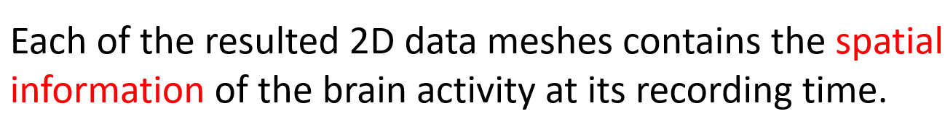
Converting 1D EEG Sequences to 2D EEG Meshes
Spatial information!

Slide 14
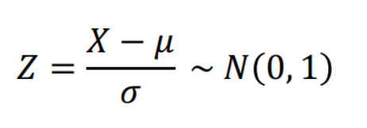
Z-Score Standardization
Z-Score normalization: rescaled to have data with
an average of 0 and a standard deviation of 1.
It does not favor data with larger unit scales.

Slide 15
Challenge and restriction
Some EEG readings are variably missing largely due to issues of electrical conductivity and subjects movement, resulting in all channels recording zeros. This issue is unavoidable in sensor-based systems, and it might not be tolerated by BCIs.

Slide 16
Similar challenge and restriction
Smooth manipulation
Poor contact
Random press
Continuously without
interruption

Slide 17
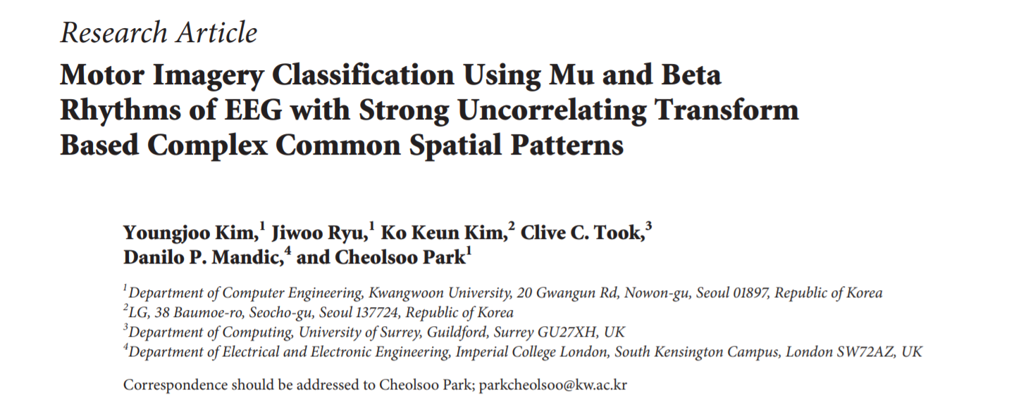
Solution

Slide 18
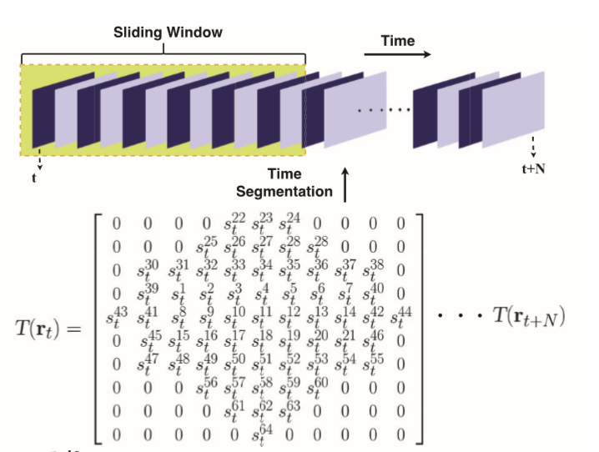
Sliding window
Sliding window with 50% overlapping between continuous neighbors.

Slide 19
Why using Convolutional Recurrent Neural Network(CRNN)
CRNNs take advantage of convolutional neural networks
(CNNs) for local feature extraction and recurrent neural
networks(RNNs) for temporal summarization of the
extracted features/support sequence prediction.
https://arxiv.org/pdf/1609.04243.pdf

Slide 20
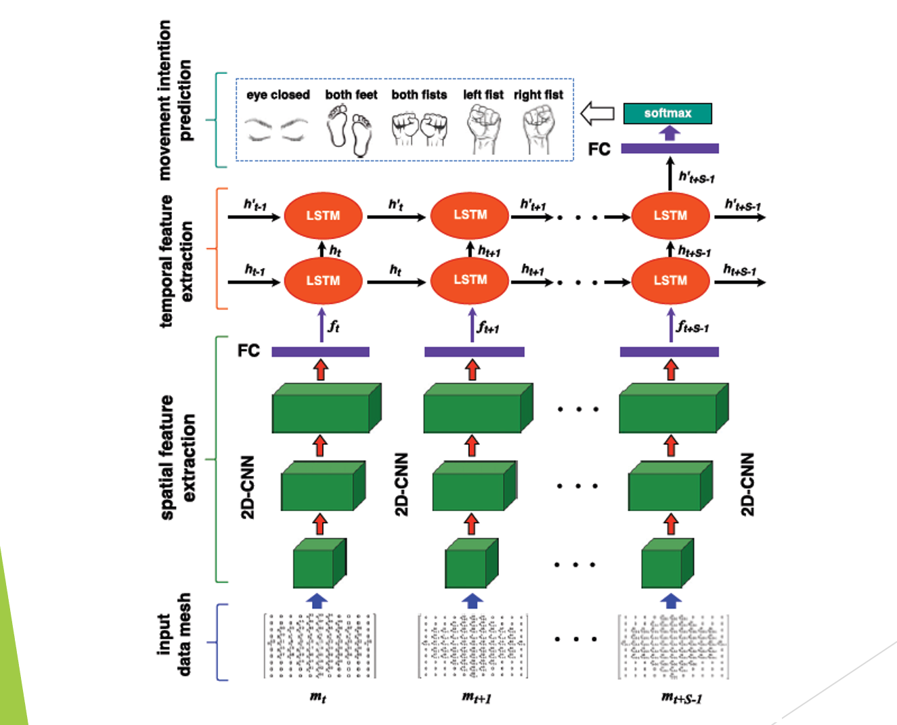

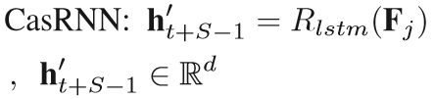


Cascade convolutional recurrent neural network

Slide 21
.We start the ﬁrst convolutional layer with 32 feature maps, and double the feature
maps in each of the following convolutional layers. As a result, there are 128 feature
maps in the last convolutional layer. After these three convolutional layers, a fully
connected layer with 1024 neurons is applied to convert the 128 feature maps to the
ﬁnal spatial feature representation fk ∈ R1024. This fully connected layer is optional
for feeding the 2D-CNN results to RNN. However, we observe that this layer is essential
in helping with convergence and marginally improvement of the performance of the whole framework.
. We induce dropout operations as a form of regularization after the fully
connected layers in both the 2D-CNN stage and the ﬁnal classiﬁcation stage.
Softmax classiﬁer ﬁnally computes the classiﬁcation probabilities over K brain intentions
for each individual segment.

Slide 22
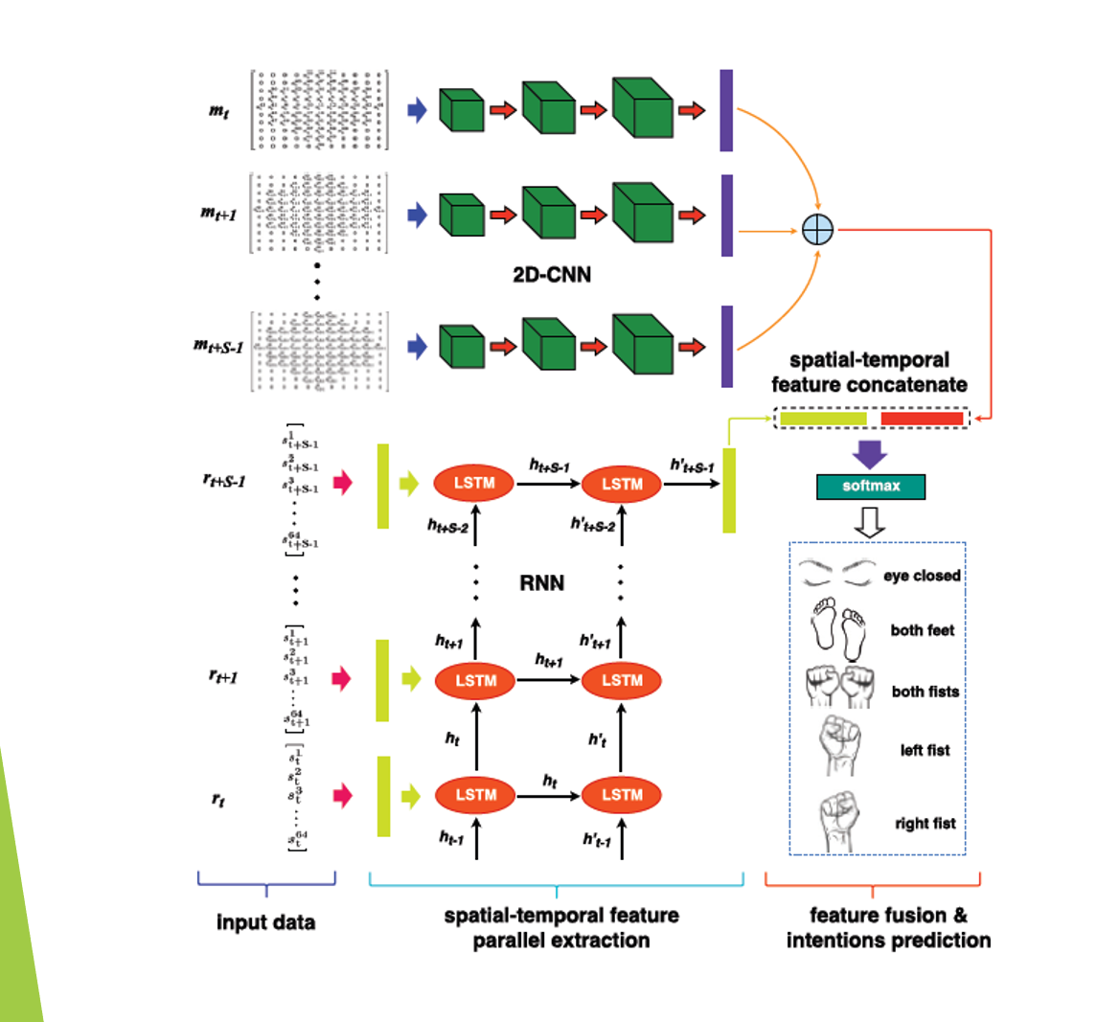
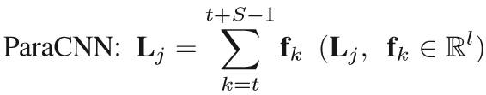
[
Parallel recurrent convolutional neural network

Slide 23
In the 2D-CNN part of both the cascade and parallel models, convolutional layers are not followed by a pooling operation.
the data dimension is much smaller than that used in computer vision research, so in order to keep all information, we concatenate three CNN layers directly without pooling operations

Slide 24
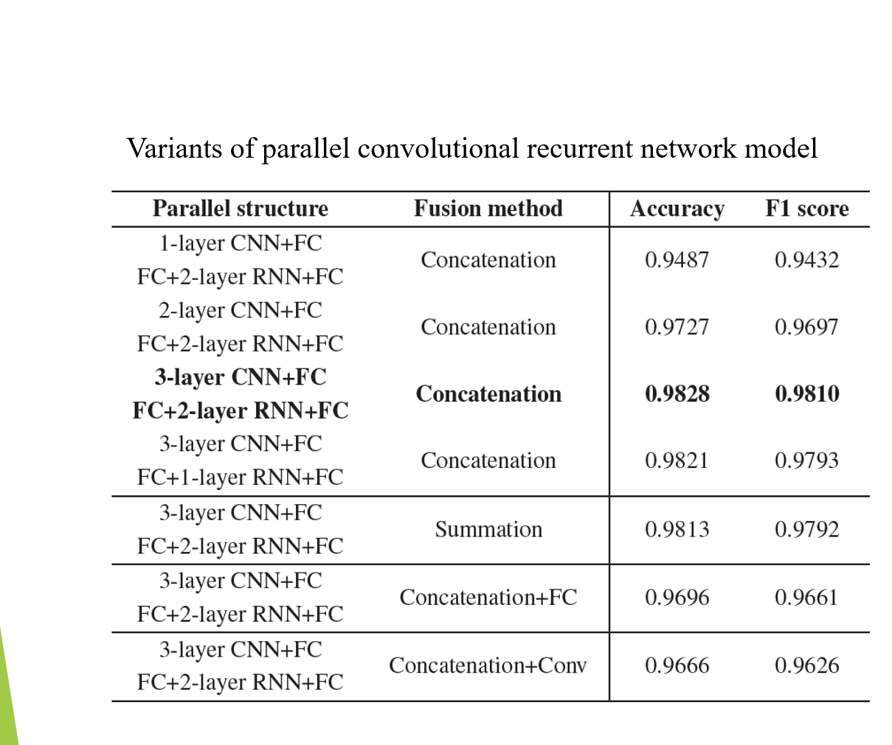
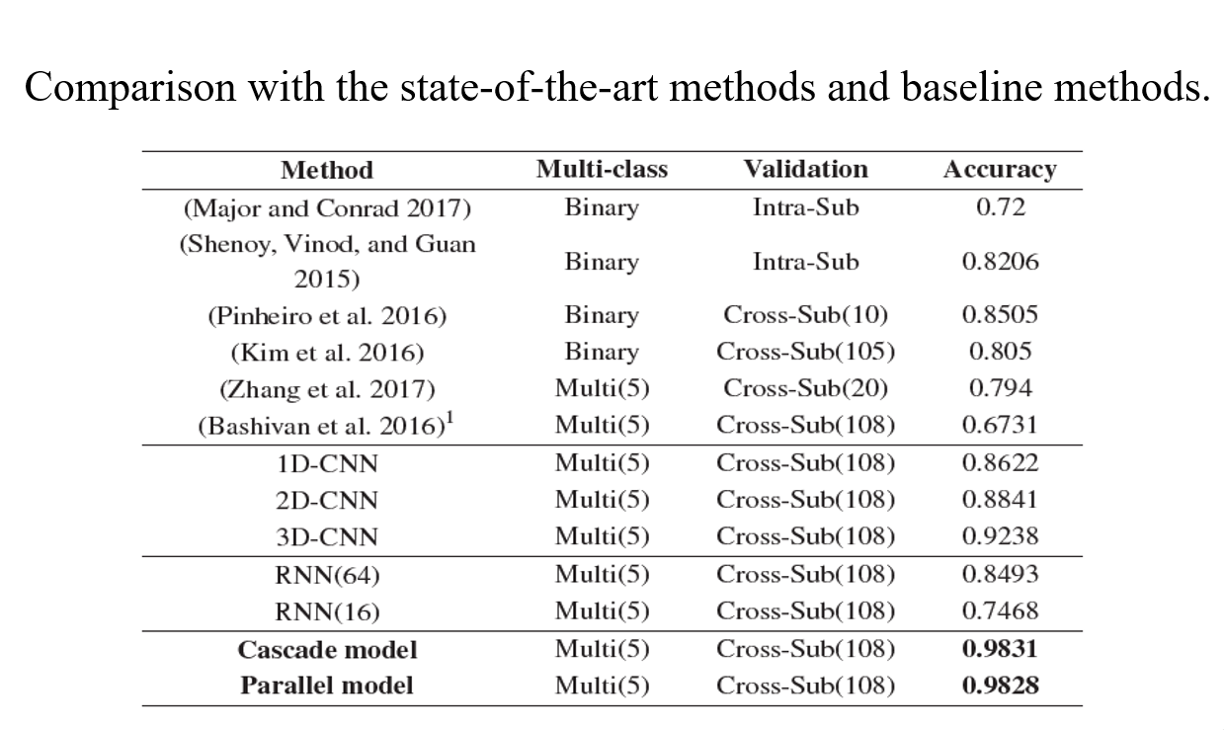
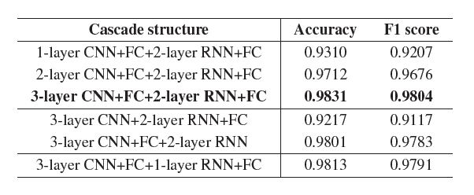
Experiment / performance result
Variants of cascade convolutional recurrent network model

Slide 25
. It is noted that increasing the CNN model’s dimension, which means adding spatial or temporalinformation,obviouslyenhancesthemodel’sperformance.
sole CNN or RNN models are not able to achieve comparative performance with both the cascade and parallel models. It is also observed that the 3D-CNN model, which just represents the local temporal information, is not as powerful as the proposed models that involve the global temporal information by the RNN parts.

Slide 26
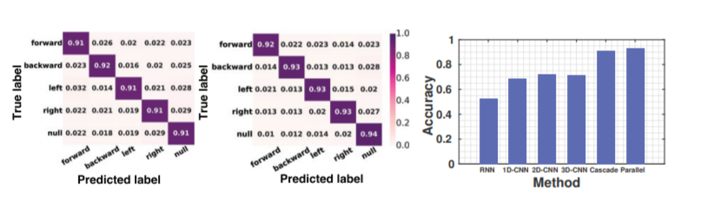
Experiment / performance result
(a)
(b)
(c)
(a) Confusion matrix of cascade model
(b) Confusion matrix of parallel model
(c) Performance comparison

Slide 27
We ﬁrst extract the spatial features of each data mesh, and then feed the sequence of the extracted spatial features into the RNN to extract temporal features. One fully connected layer receives the output of the last time step of the RNN layers, and feeds the softmax layer for ﬁnal intention prediction

Slide 28
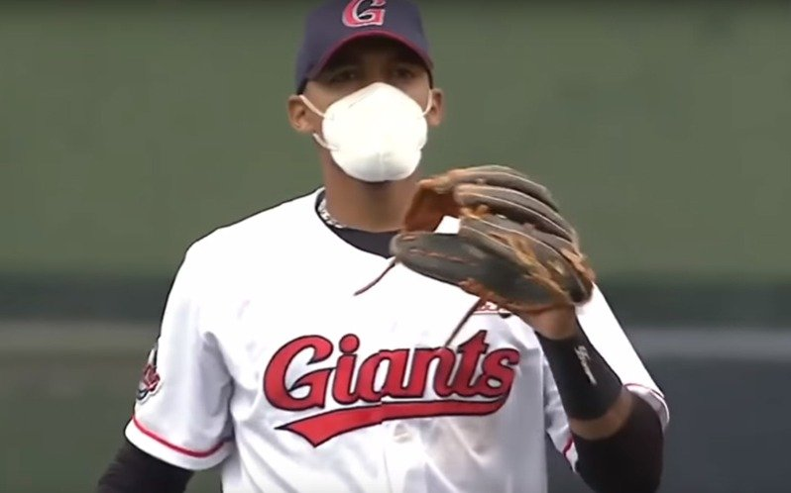
What we want?
Velocity
Spin rate
Spin direction
3D trajectory
Spin efficiency
Release height
Release angle
And so on……….
https://rapsodo.com/baseball/pitching/

Slide 29
Obstacles/ improvement/
Noise/ unintentionally applied force
=> Filter or Anomaly filter or Anomaly repair
(in preprocessing)
2. Traditional LSTM can try: change to BiLSTM or Seq2seq
3. Attention mechanism
(put more attention to the points we concern about)

Slide 30
Dataset
Our lab becomes the first public baseball finger force sensing
datasets provider.
2. If so, it needs group of people collect data specifically in
order to confirm the quality of the dataset.
Problems concerning about using dataset in the experiment
section for writing papers in the future.(No Authoritative dataset)

Slide 31
Discussion and feedback

